Slide 1

-Testarea SW- AUTOMATIC MANAGEMENT of FACULTY STUDENTS - AMFS
Zane Livia
Stefan Ionut Valentin
Simion Ramona Maria

Slide 2
Unit Testing
Unit Testing - is a software testing method by which individual units of source code are tested to determine whether they are fit for use.
Unit tests are typically automated tests written and run by software developers and QA departments to ensure that a section of an application (known as the "unit") meets its design and behaves as intended.
To isolate issues that may arise, each test case should be tested independently. Substitutes such as method stubs, mock objects, fakes, and test harnesses can be used to assist testing a module in isolation..
To unit testing AMFS application are used NUnit Framework and Moq Library from NuGet Packages within Microsoft Visual Studio 2022. Regarding test methods are used fakes and mock objects.
For code cover by tests analysis are used Coverlet Collector and Report Generator Libraries, also from NuGet Packages.
Beside the 20 automated unit tests for controllers and services, presented in following slides, in the last three slides are presented results of manual testing for three test cases.

Slide 3
Unit Testing
In a unit test, mock objects can simulate the behaviour of complex, real objects and are therefore useful when a real object is impractical or impossible to incorporate into a unit test.
Mock objects have the same interface as the real objects they mimic, allowing a client object to remain unaware of whether it is using a real object or a mock object.
Many available mock object frameworks allow the programmer to specify which, and in what order, methods will be invoked on a mock object and what parameters will be passed to them, as well as what values will be returned.
A fake object implements the same interface as a real object but takes shortcuts to improve performance. Fakes are generally used when we need to test something that depends on an external service or application, and we don’t want to make actual calls to that service or application.
Classification between mocks, fakes, and stubs is highly inconsistent across the literature but, though, they all represent a production object in a testing environment.

Slide 4
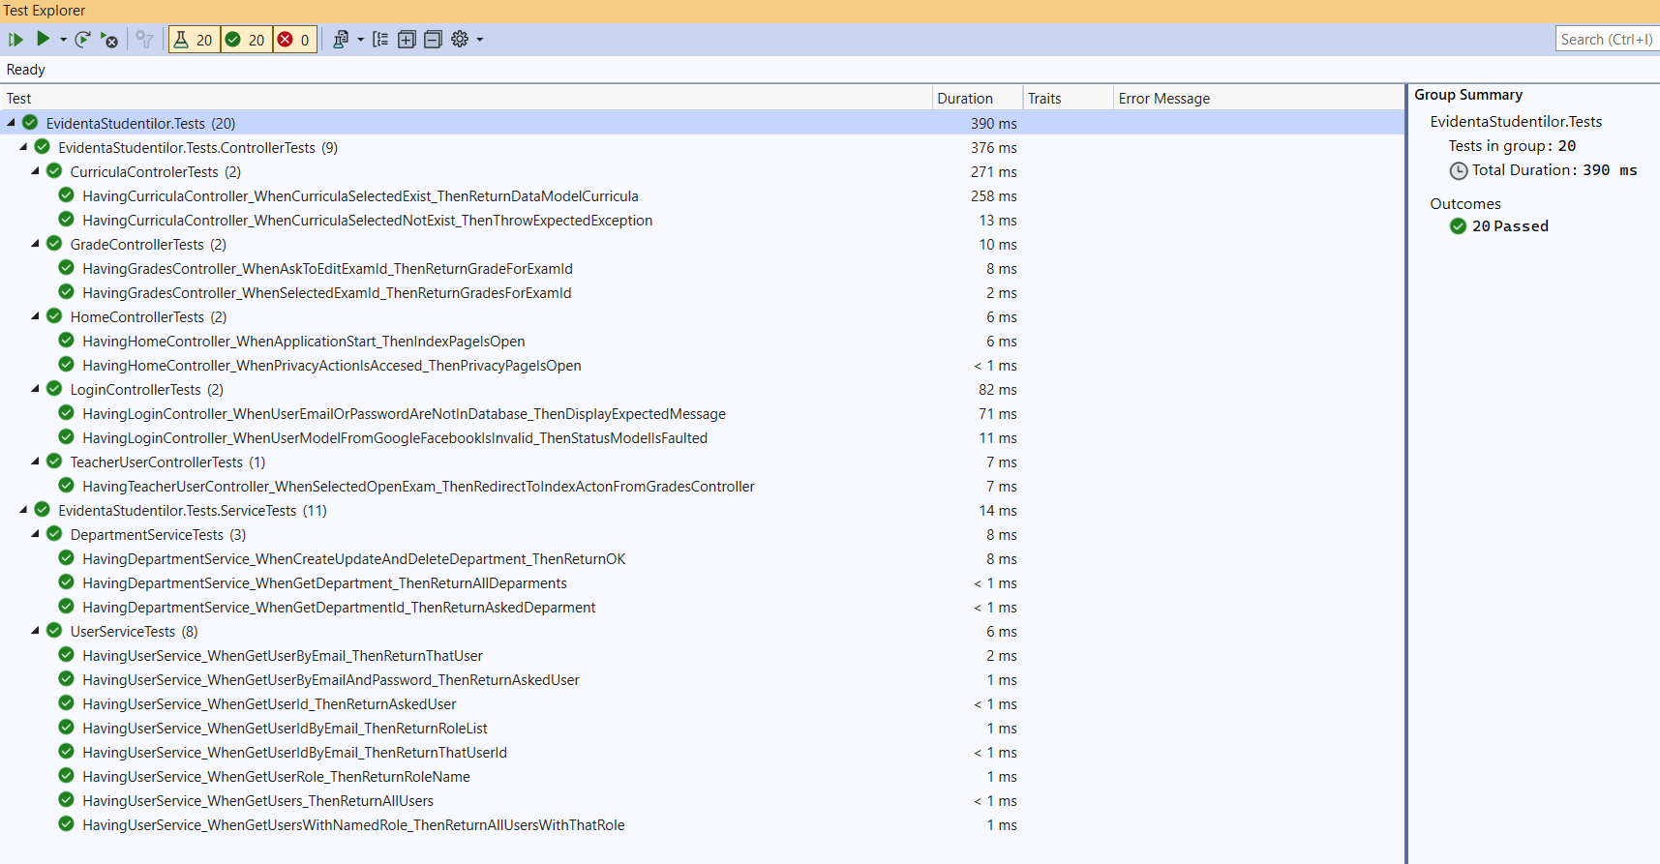
The tests running without errors

Slide 5
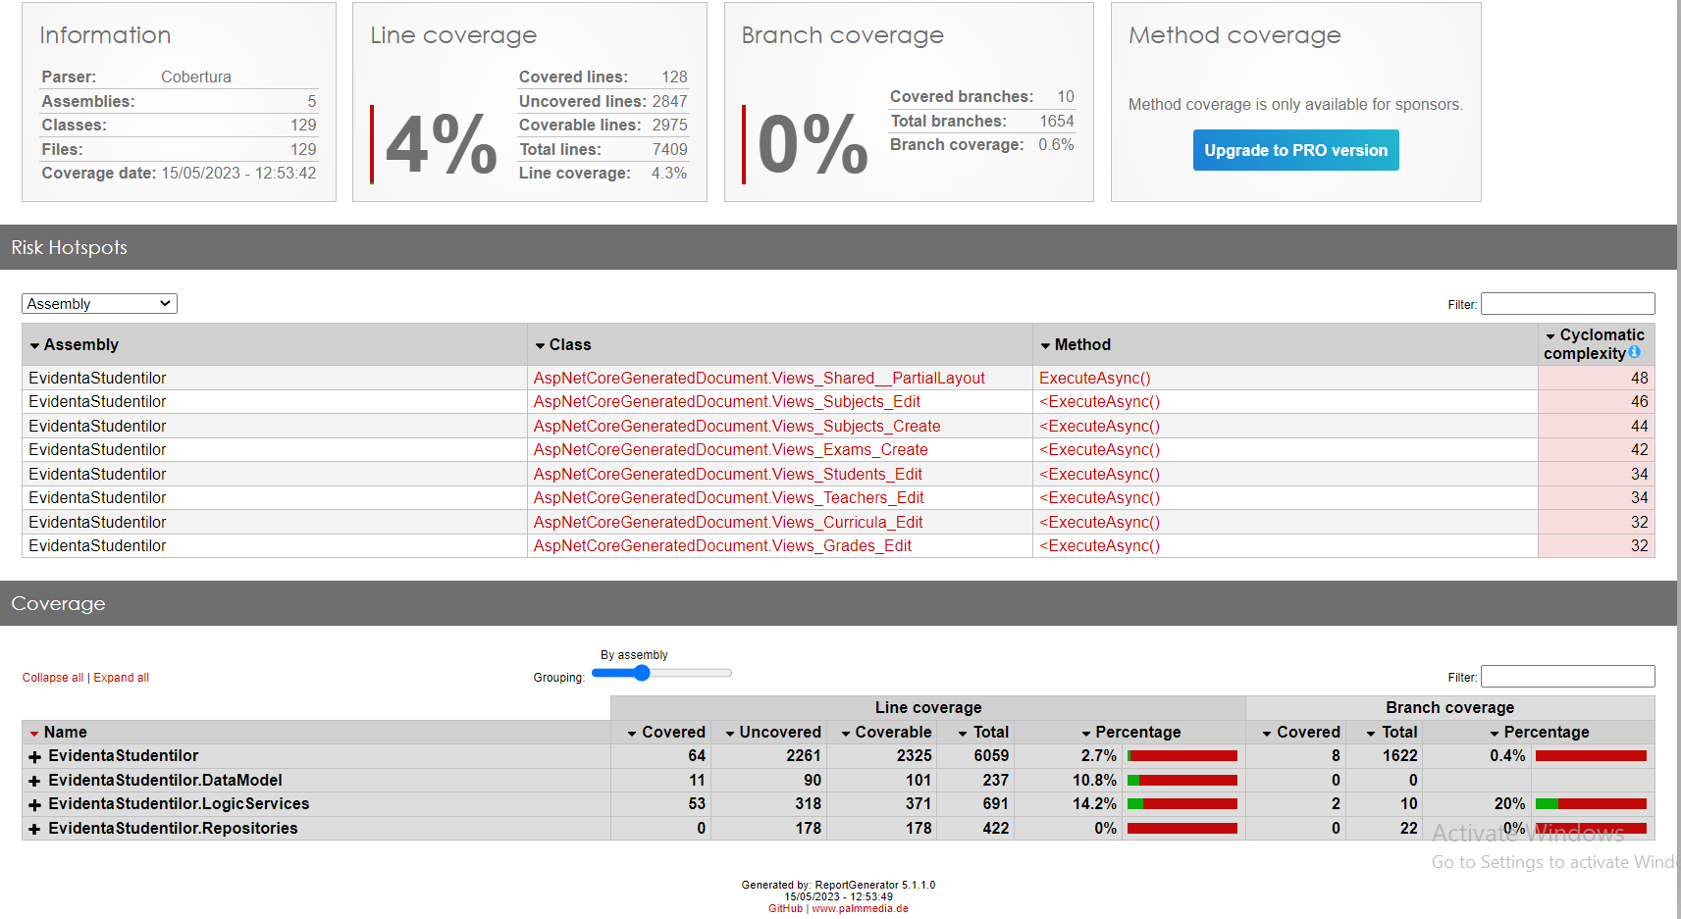
Tests code cover report

Slide 6
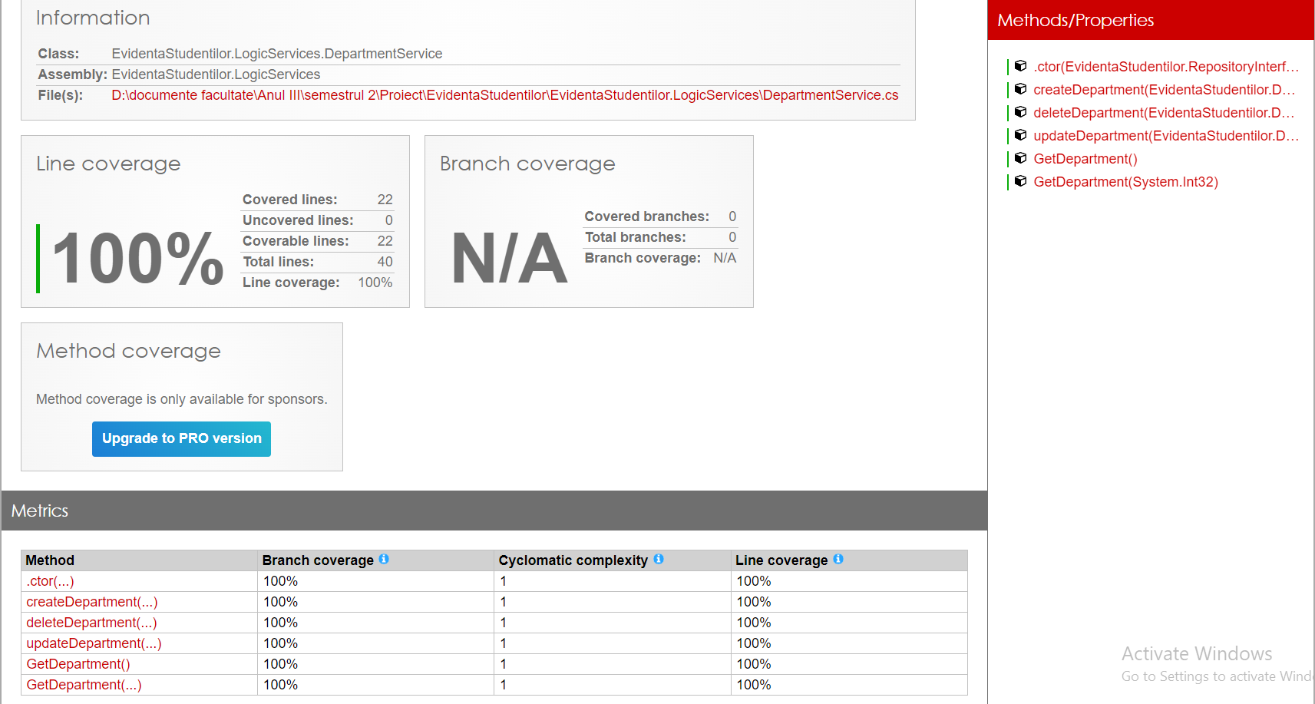
Tests for Department Service

Slide 7
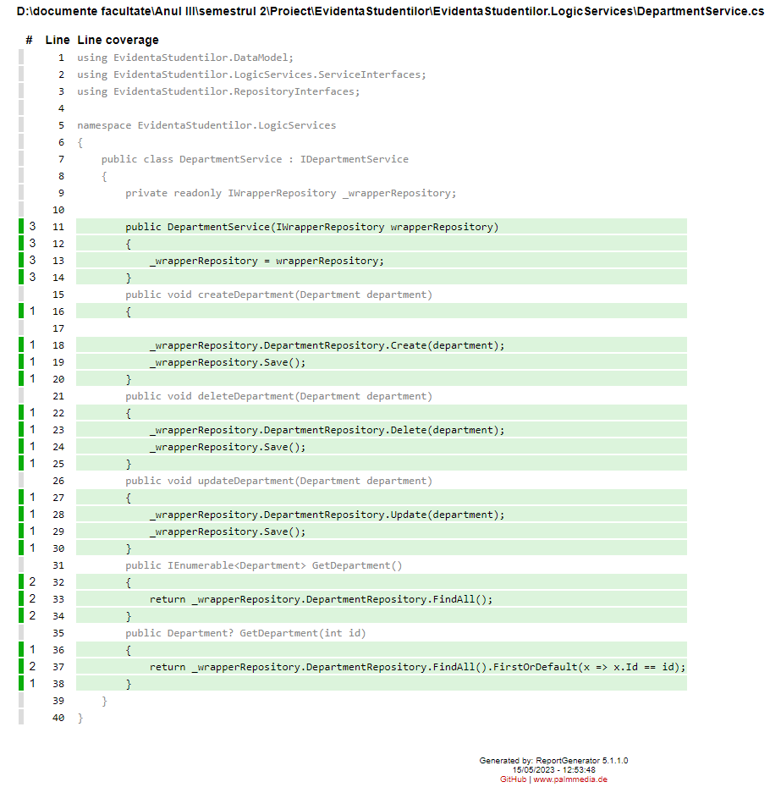
Test code cover for Department Service

Slide 8
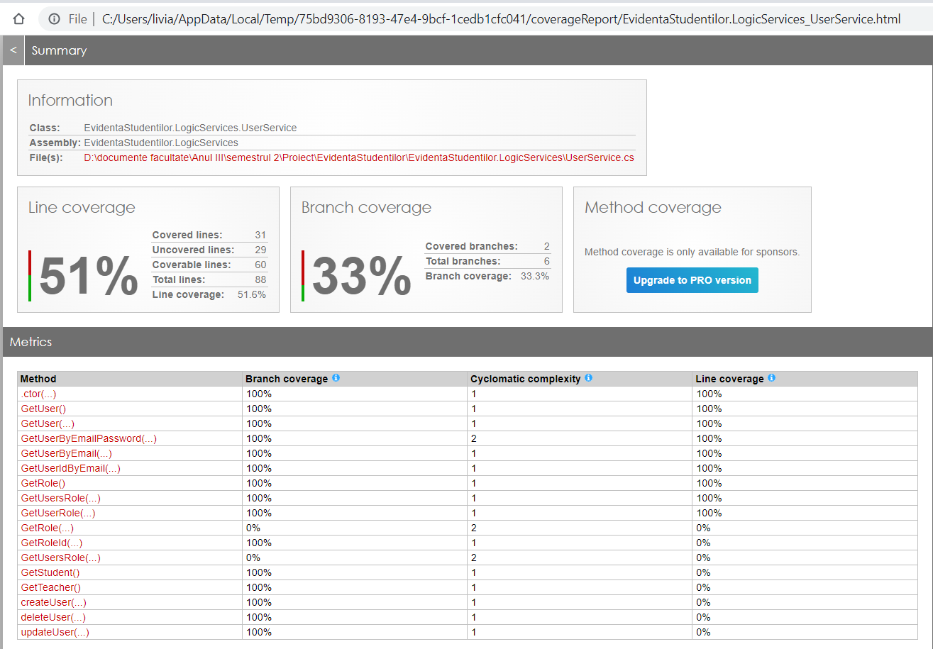
Tests for User Service

Slide 9
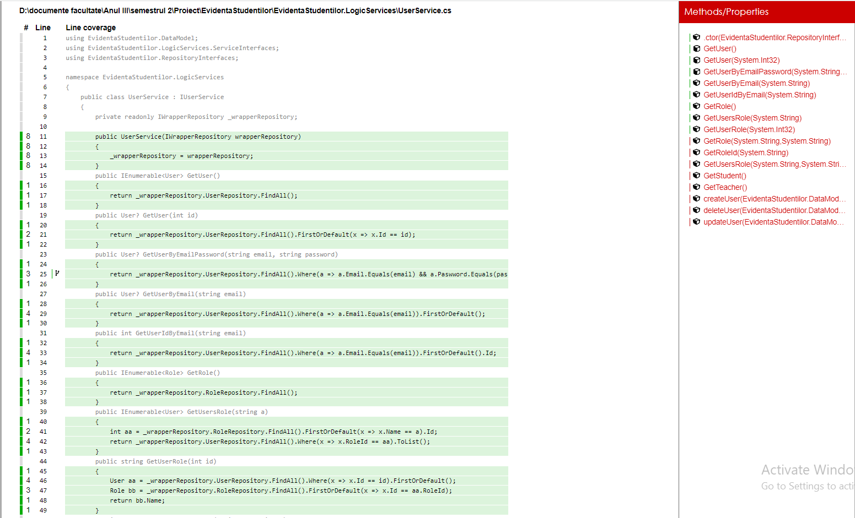
Test code cover for User Service

Slide 10
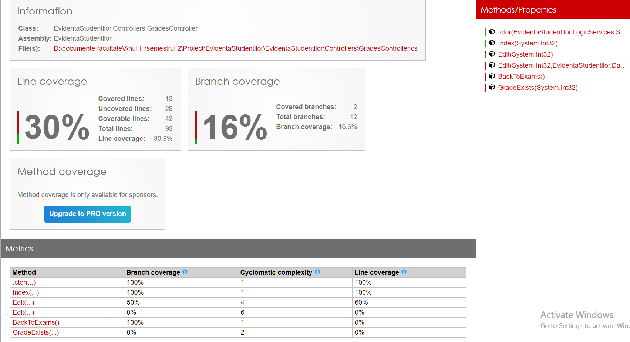
Tests for Grades Controller

Slide 11
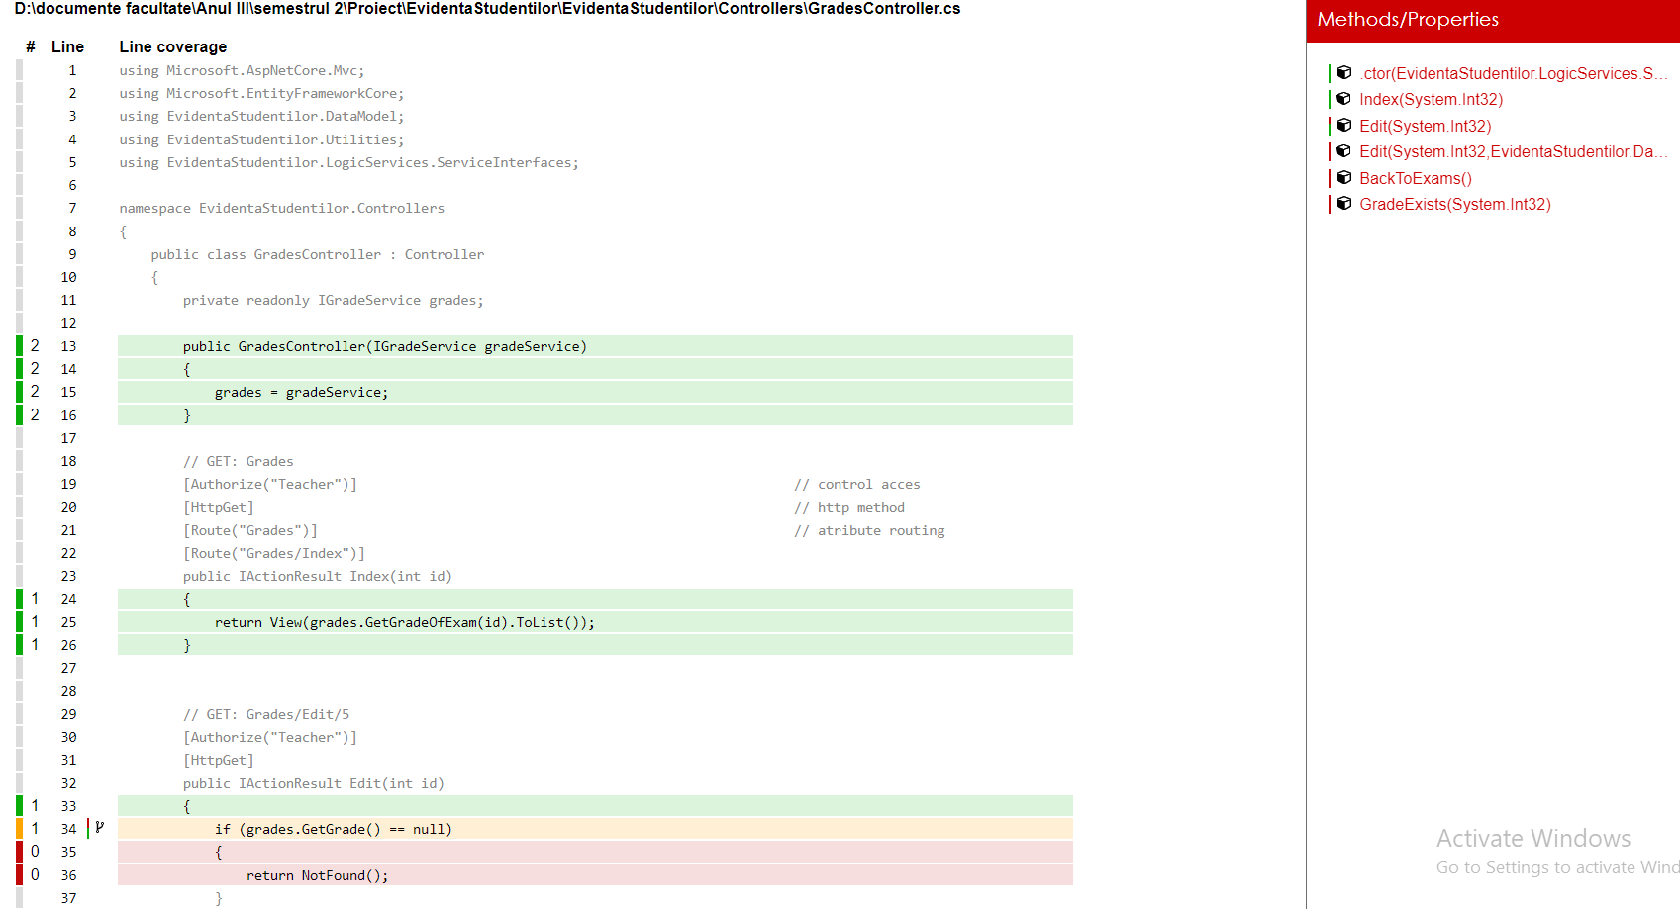
Test code cover for Grades Controller

Slide 12
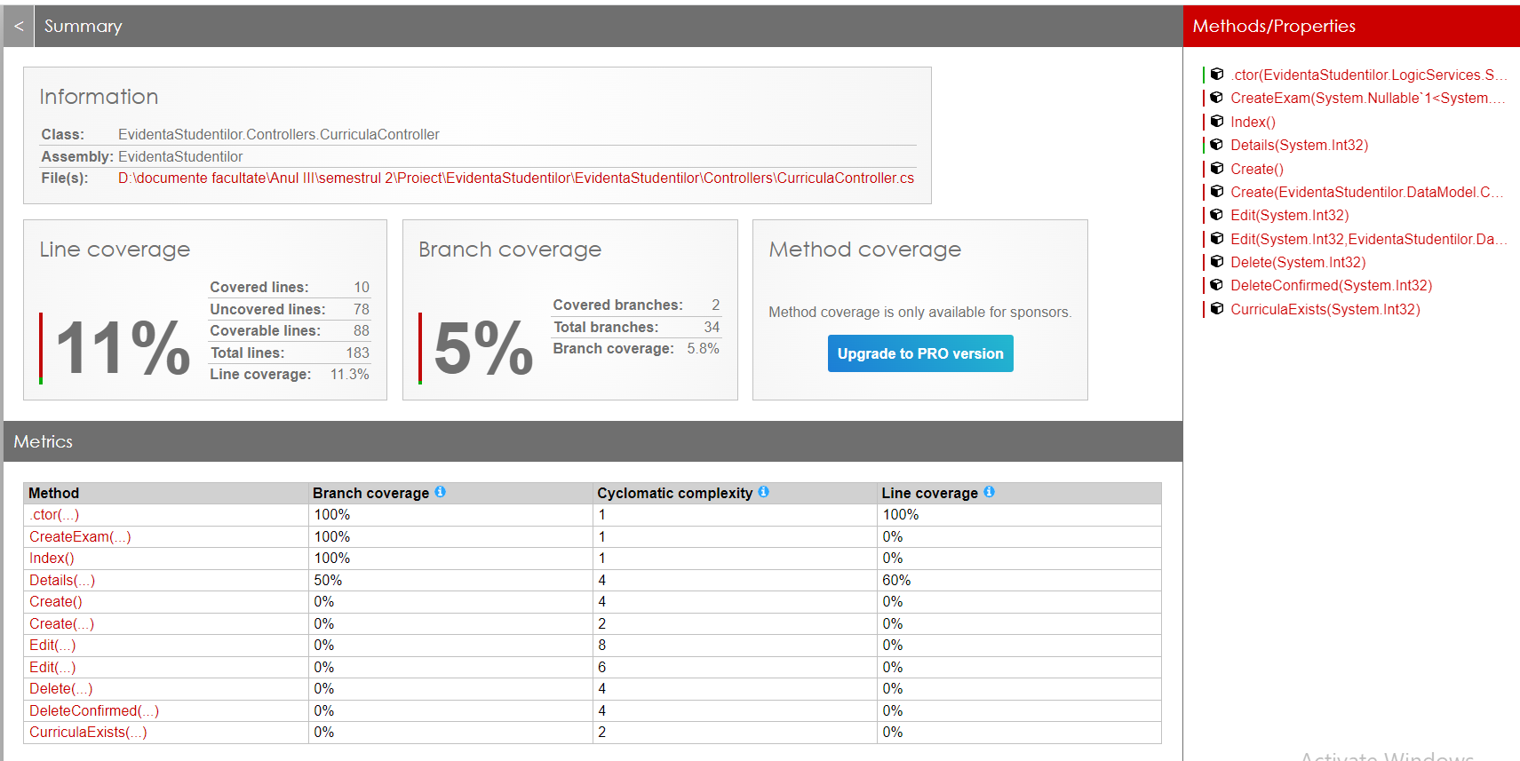
Tests for Curricula Controller

Slide 13
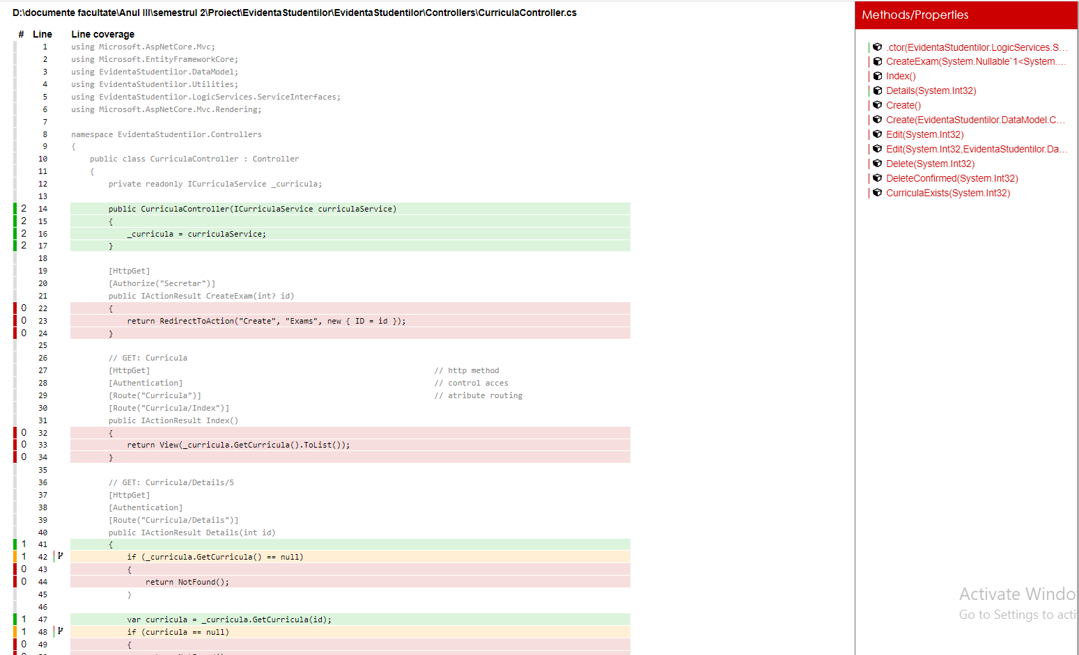
Test code cover for Curricula Controller

Slide 14
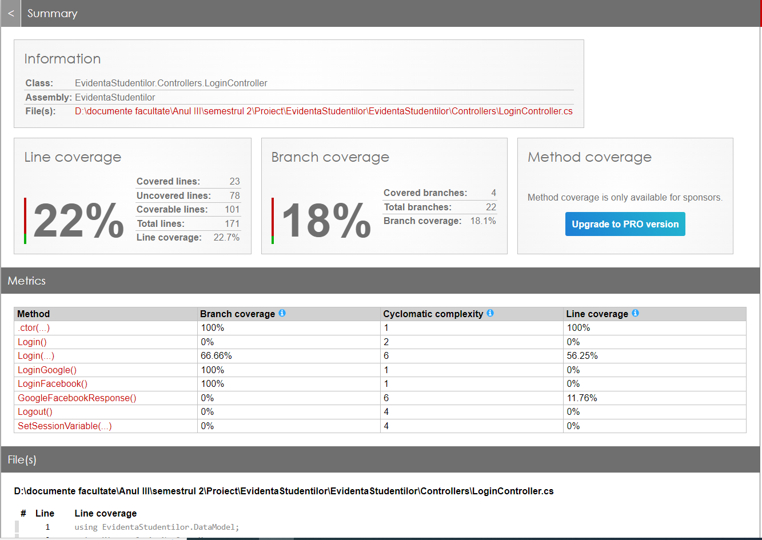
Tests for Login Controller

Slide 15
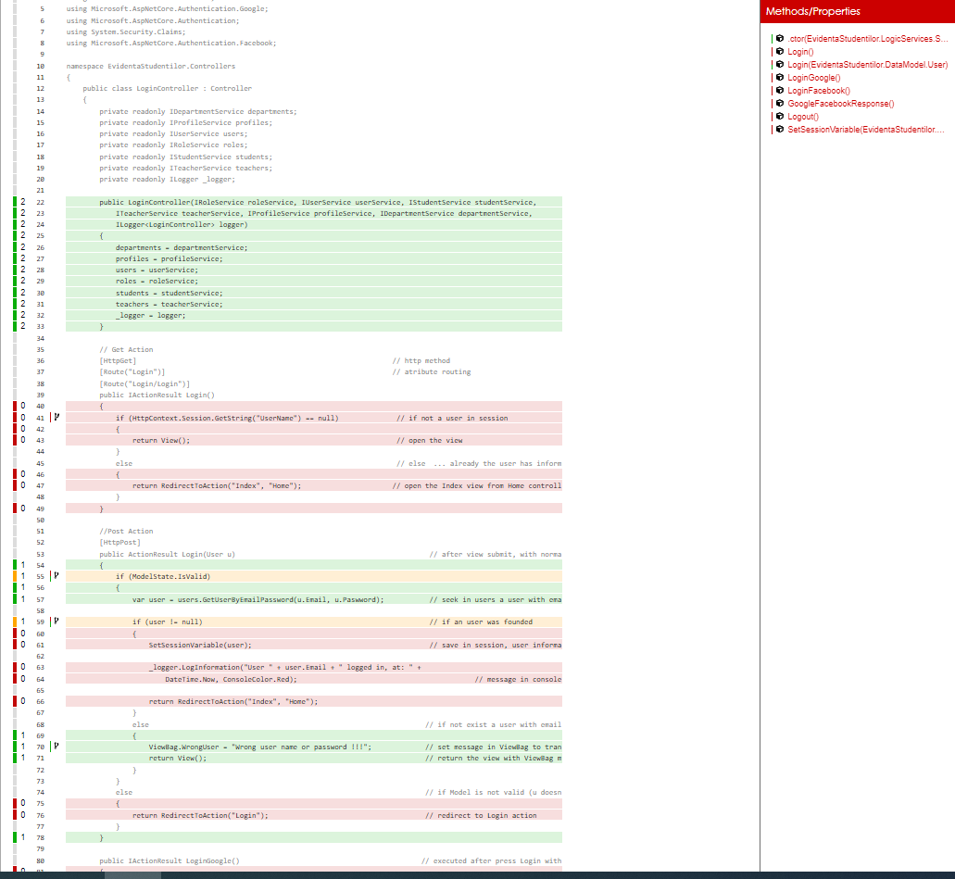
Test code cover for Login Controller

Slide 16
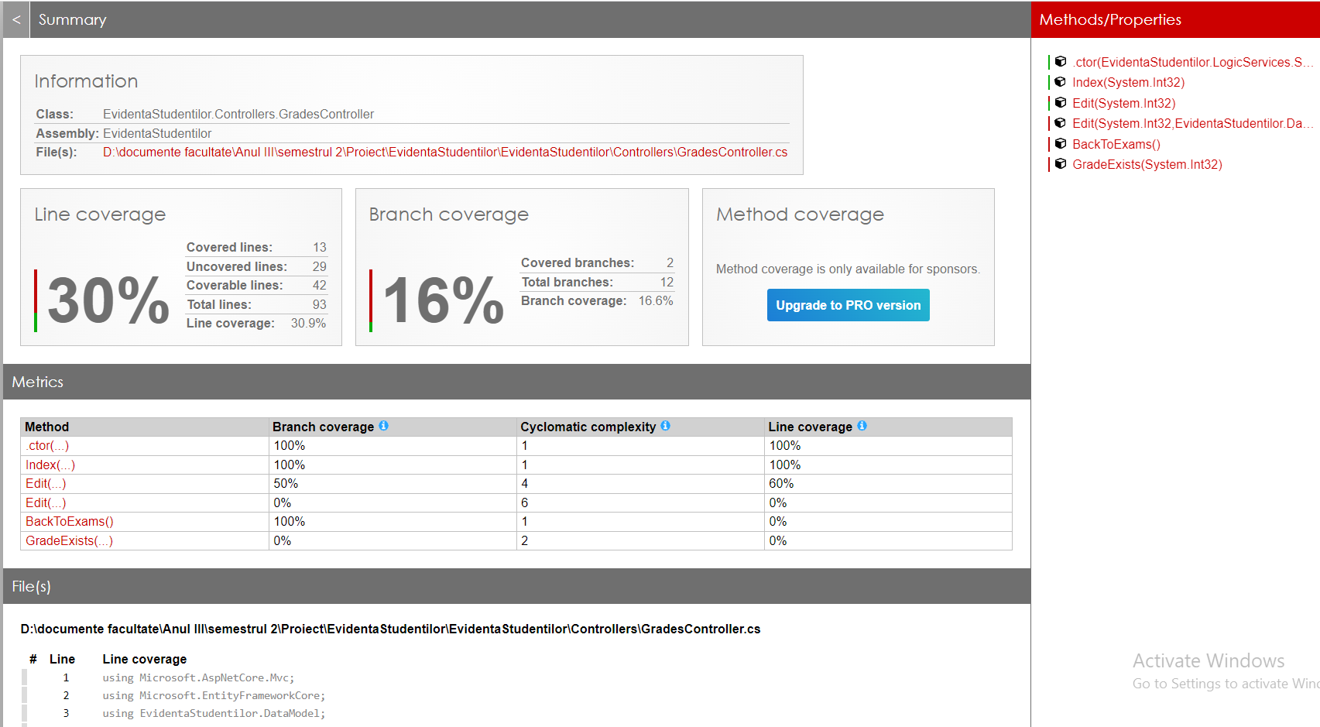
Tests for Home Controller

Slide 17
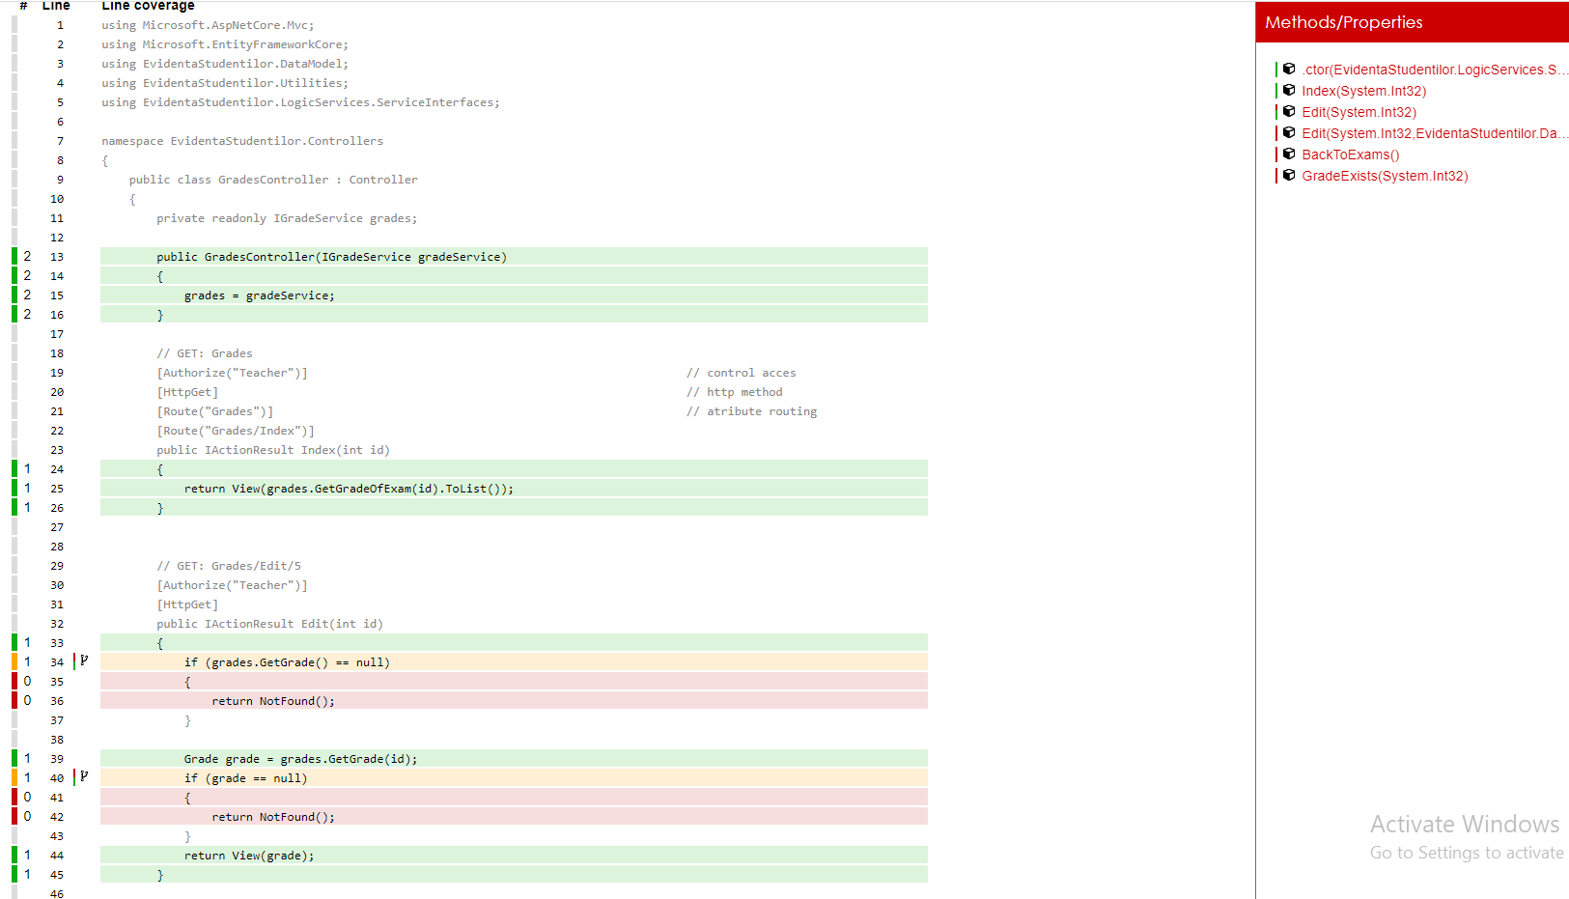
Test code cover for Home Controller

Slide 18
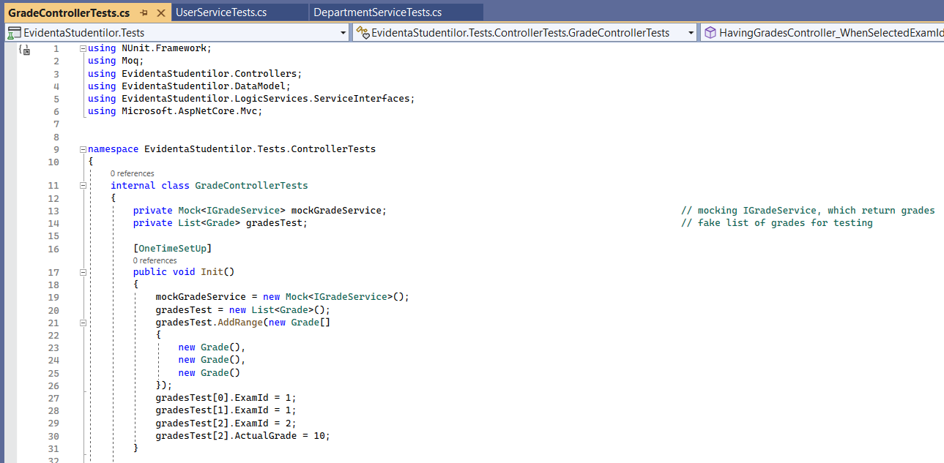
Unit tests for Grade Controller (1)

Slide 19
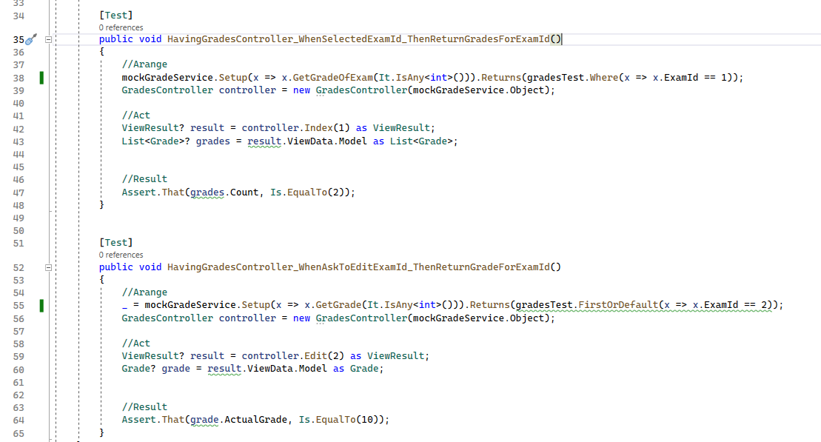
Unit tests for Grade Controller (2)

Slide 20
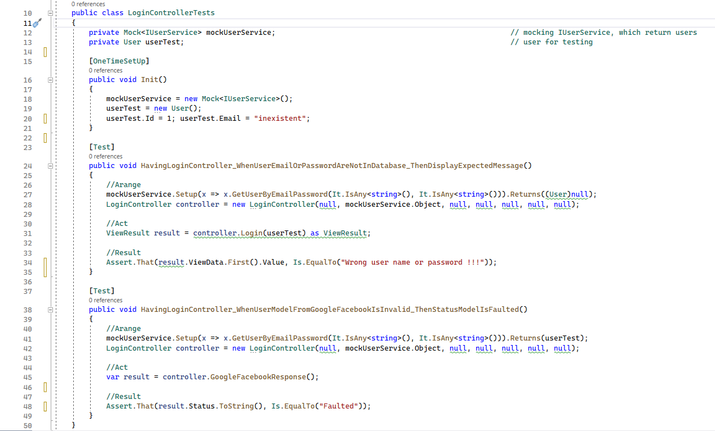
Unit tests for Login Controller

Slide 21
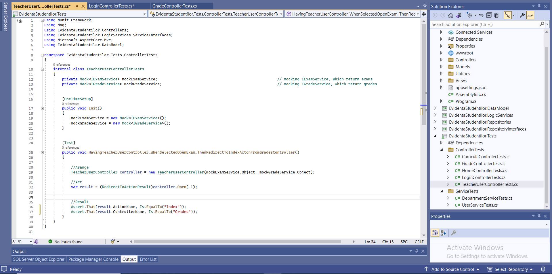
Unit tests for Teacher User Controller

Slide 22
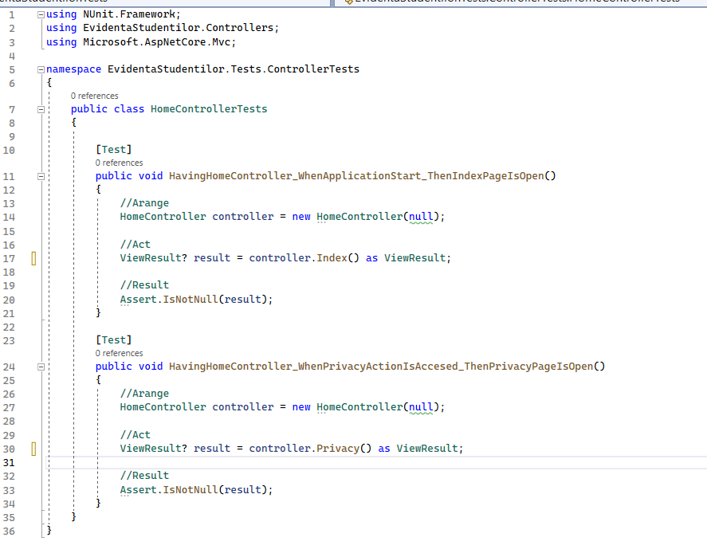
Unit tests for Home Controller

Slide 23
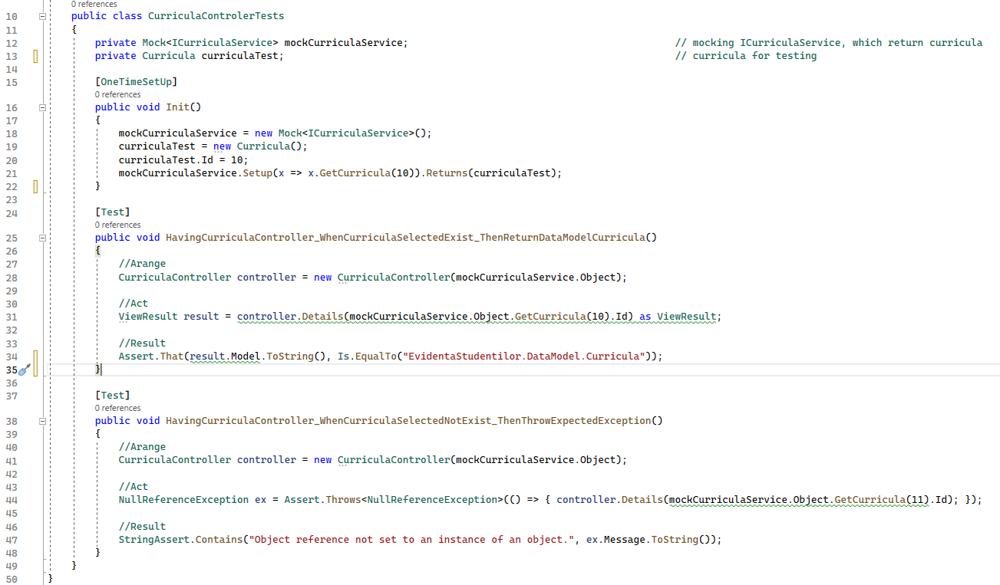
Unit tests for Curricula Controller

Slide 24
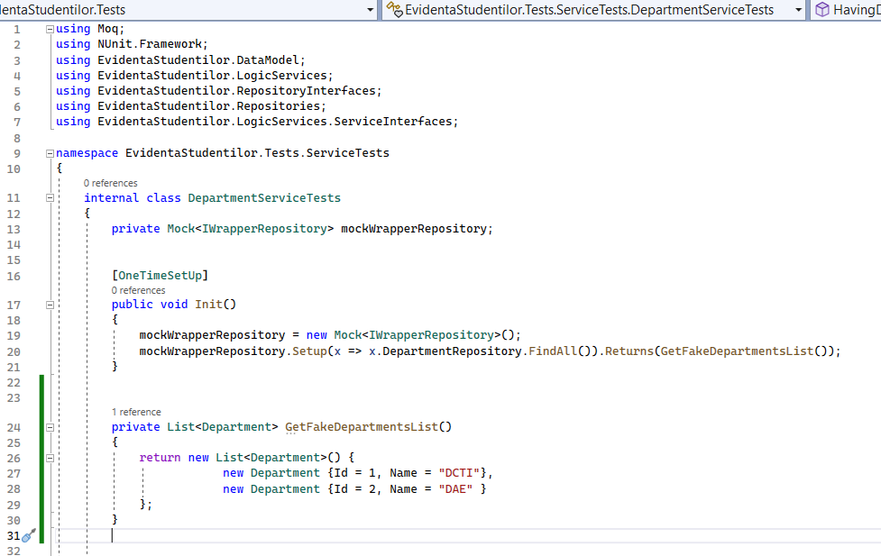
Unit tests for Department Service (1)

Slide 25
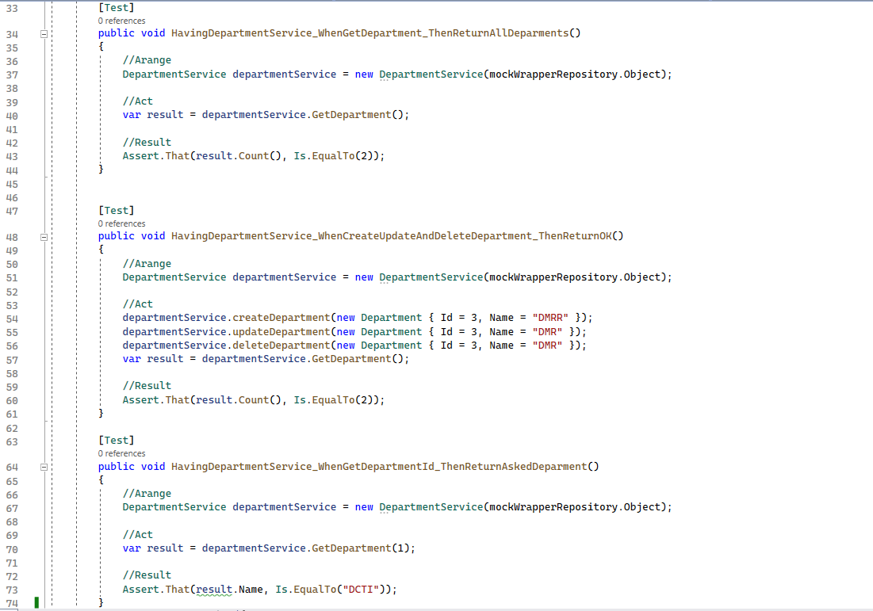
Unit tests for Department Service (2)

Slide 26
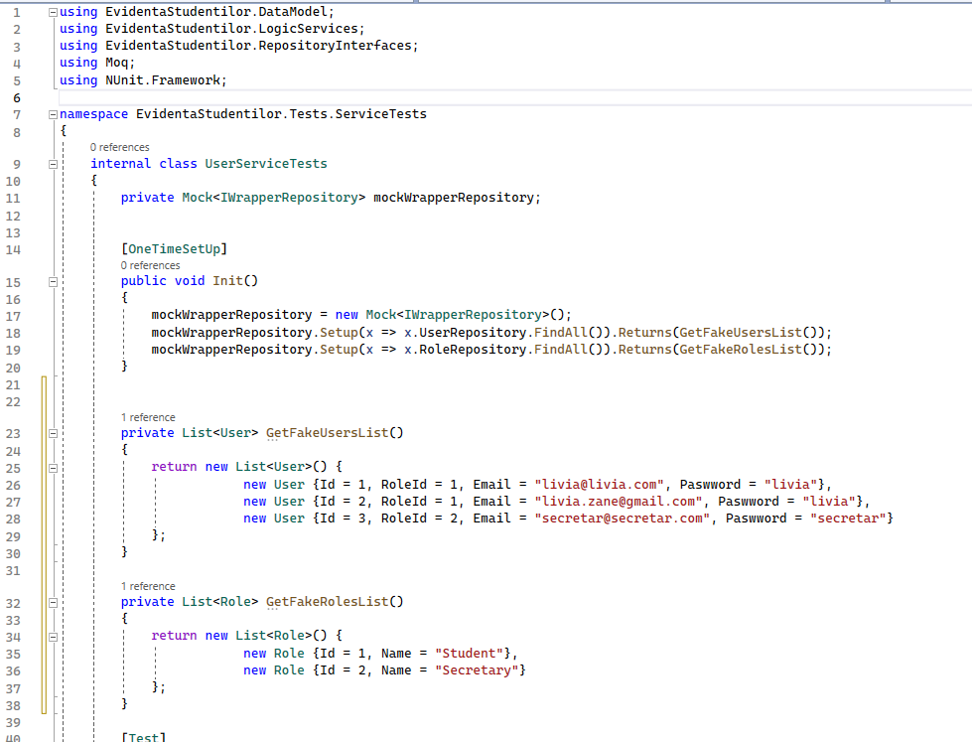
Unit tests for User Service (1)

Slide 27
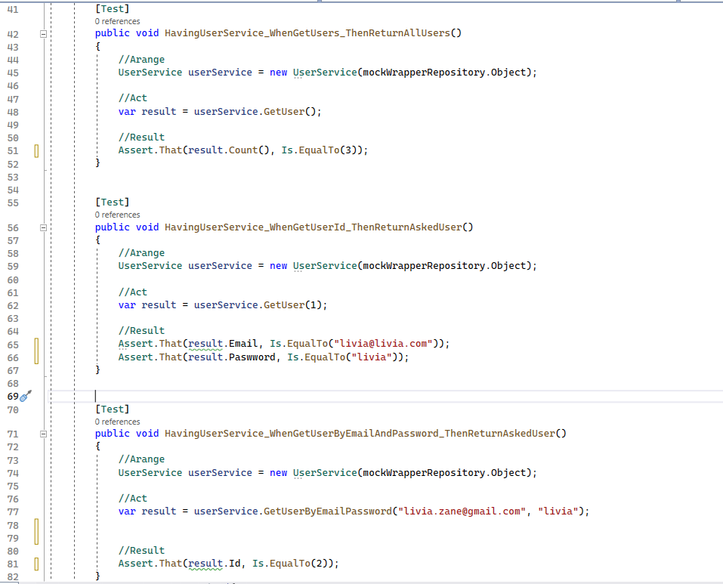
Unit tests for User Service (2)

Slide 28
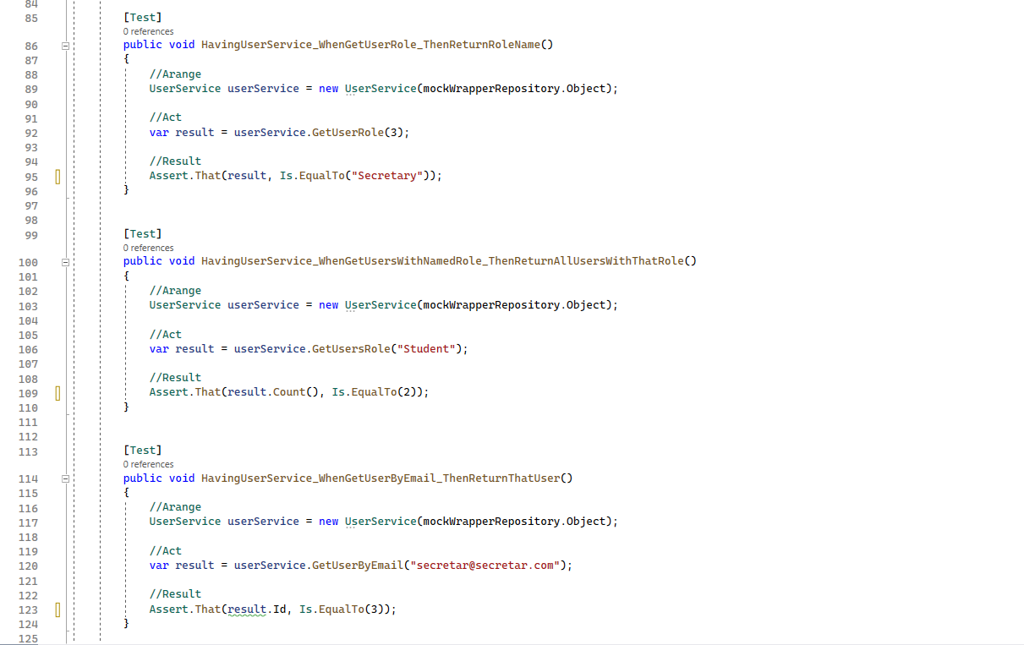
Unit tests for User Service (3)

Slide 29
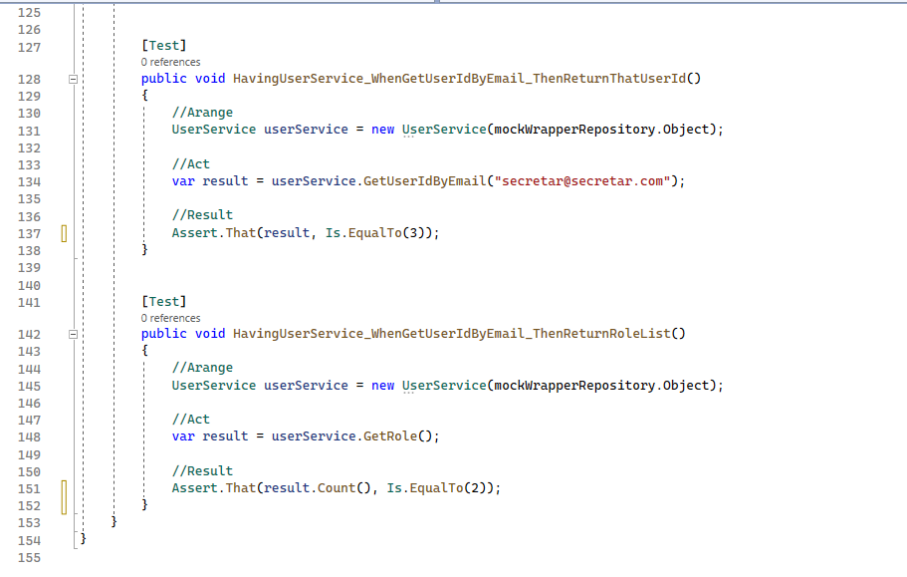
Unit tests for User Service (4)

Slide 30
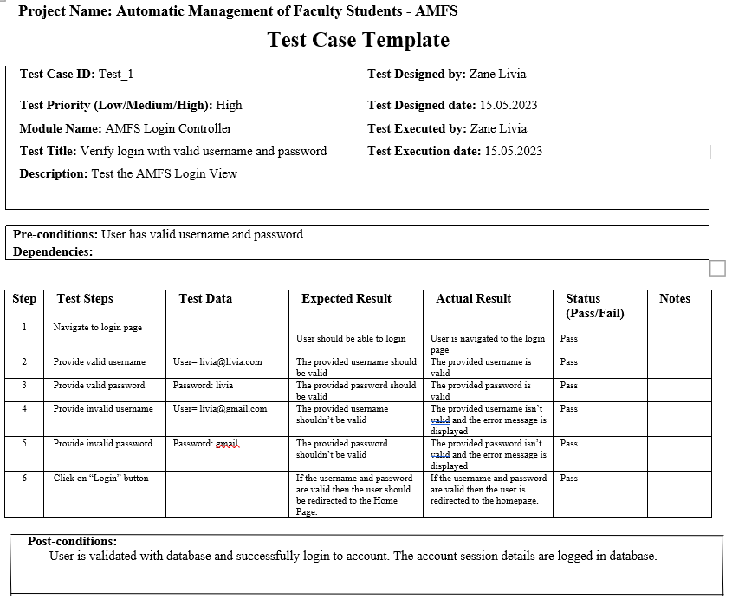
Manual tests for views

Slide 31
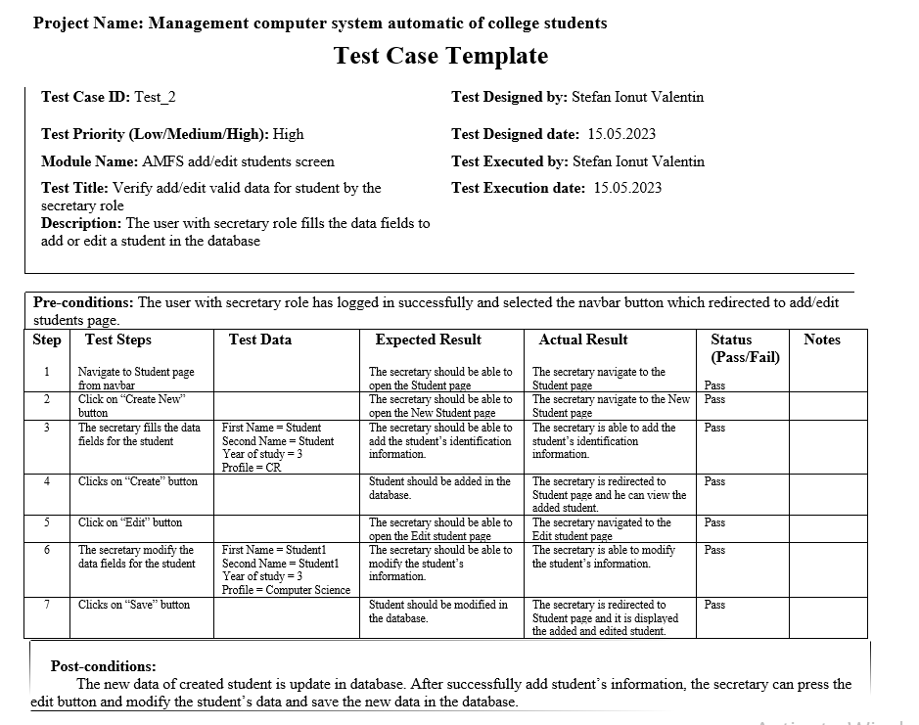
Manual tests for views

Slide 32
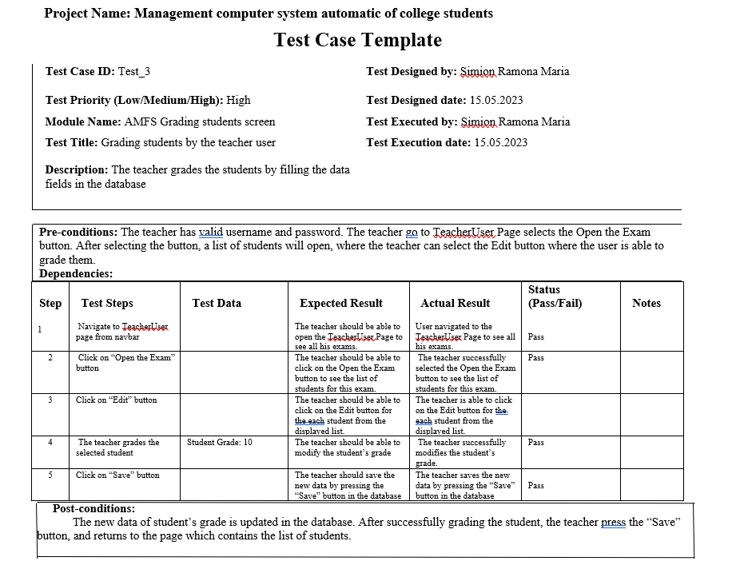
Manual tests for views

